Slide 1
Bridging the gap - forward thinking enterprises are hybrid
John Mertic
Director, Open Mainframe Project
Notes:
In this talk, we will focus on how forward thinking enterprises leverage hybrid infrastructure rather than any one approach to their IT infrastructure. In the past several years, more and more organizations use their computing infrastructure as a strategic advantage; buying off the shelf they view is keeping them at the same level as their competitors, but leveraging computing infrastructure that solves their business problems specifically helps them be more efficient and better engage their customers.

Slide 2

A (Brief)* History of Computing Infrastructure
(*) note that this is intentionally NOT an through history. We only have so much time :-)
Notes:
To understand the backdrop of how these organization got here, let’s look back at the history of computing infrastructure

Slide 3

1960s through mid 2000s
Physical infrastructure under one roof
Proprietary, single vendor to streamline support
Slowly evolving - business adapted to technology instead of technology adapting to business
Notes:
The traditional organization would often go with one vendor for their infrastructure, as vendors could streamline support which generally made organizations feel they’ve made “safe” choices.
The downside is that these technologies evolved much slower than today. Part of this was access to hardware and software ( both expensive ) with another part the tech industry still maturing.

Slide 4



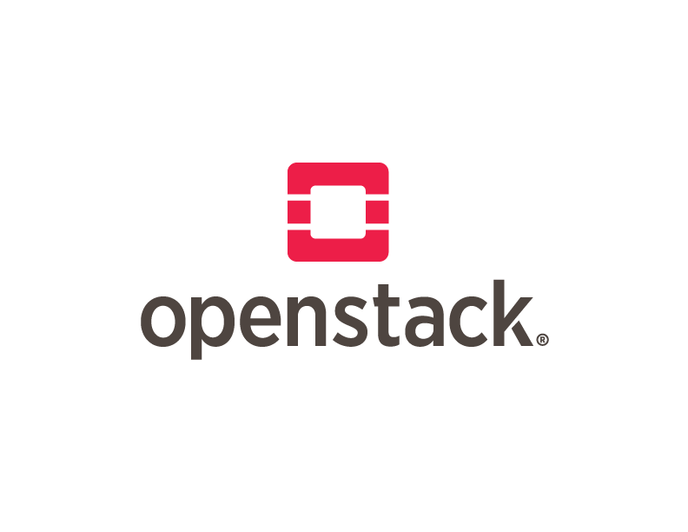
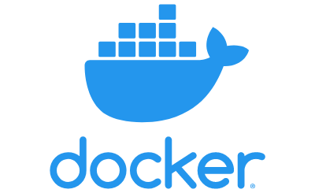

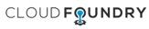

Infrastructure evolves
Non- Virtualized
Hardware
Open Source
IaaS
Open Source
PaaS
Cloud Native
Virtualiza- tion
IaaS
PaaS
Containers
2000
2001
2006
2009
2010
2011
2013
2015
Notes:
We see the greatest shift over the past 2 decades, where non-virtualized hardware which was the normal was replaced by virtualized hardware; a huge leap forward in more economically using server infrastructure.
With AWS coming to market in the mid-2000s, virtualization slowly replaced by cloud computing; in the early days as monolithic services, but over time shifting to containerization, cloud native, and serverless computing. That’s a huge shift over 20 years.

Slide 5

Technology now adapts to business
Infrastructure is hybrid and fluid
Applications are deployed across infrastructures
“Microservices”
Nodes are interconnected
Open source is the connective thread
Notes:
The net of these changes is that organization have realized that infrastructure doesn’t need to be “static”, but can be “dynamic”. Microservices have let organizations move from a monolithic deployment model to one where an application can be deployed across multiple nodes, even ones that might be on different continents or entirely different platforms, yet still stay interconnected.
What has enabled this rapid change? Open Source. As the rise of cloud native has been driven by open source, the entire infrastructure layer has went open source which has driven faster innovation.

Slide 6
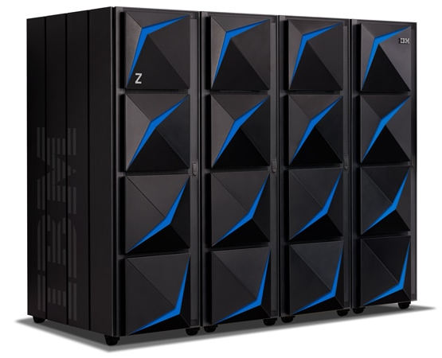
So what about mainframe?
Mainframe is the only platform with these design principles...
Security
Availability
Scalability
Performance
...all turned up to an 11, built on decades of expertise and critical infrastructure use.
(queue Spinal Tap :-) )
Notes:
So what about mainframe? Well, if you’d ask some in mainframe, they’ll first tell you “we did all this stuff decades ago!”.
But more seriously, this architecture is one of the few built with key design principles in mind since its inception. It’s the only platform that hits all 4 of those principles at an 11 - thanks to decades of expertise and critical infrastructure usage. Our society is powered by mainframe systems; from banking to transportation to health care. No other platform beat mainframe on those four design points.
But mainframe is perceived to not fit into this DevOps centric, hybrid infrastructure world. How is that being addressed?

Slide 7

How to cross the gap? Open Source
Notes:
Or better put, how do you cross this gap? Open Source - that same connective thread that every other infrastructure is focusing on in the DevOps centric world.

Slide 8
Enter Open Mainframe Project
Open Mainframe Project believes…
that leading organizations leverage their technology infrastructure as a competitive advantage.
that the mainframe design principles of security, stability, scalability, and performance are important to these leading organizations
having the mainframe interoperable in a hybrid infrastructure enables leading organizations to realizes it’s benefits.
technical advancements that are needed by the mainframe community can be better achieved through open source.
Notes:
Open Mainframe Project was founded in 2015 to be the focal point for the growth of open source on mainframe.
Take a look at the Open Mainframe Project’s principles.
The project believes that interconnected mainframe happens through open source, and achieving this is only possible as a community effort.

Slide 9
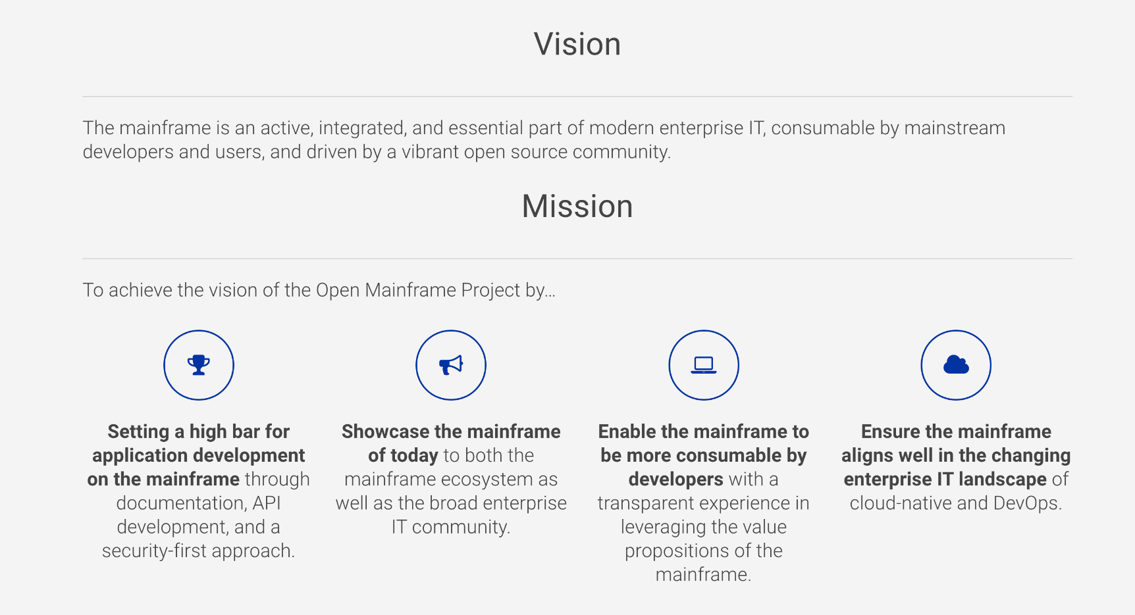
Notes:
The mission of the Open Mainframe Project is to build that community and adoption of Open Source on the mainframe, which will ( read points above )
Image from https://www.openmainframeproject.org/about

Slide 10
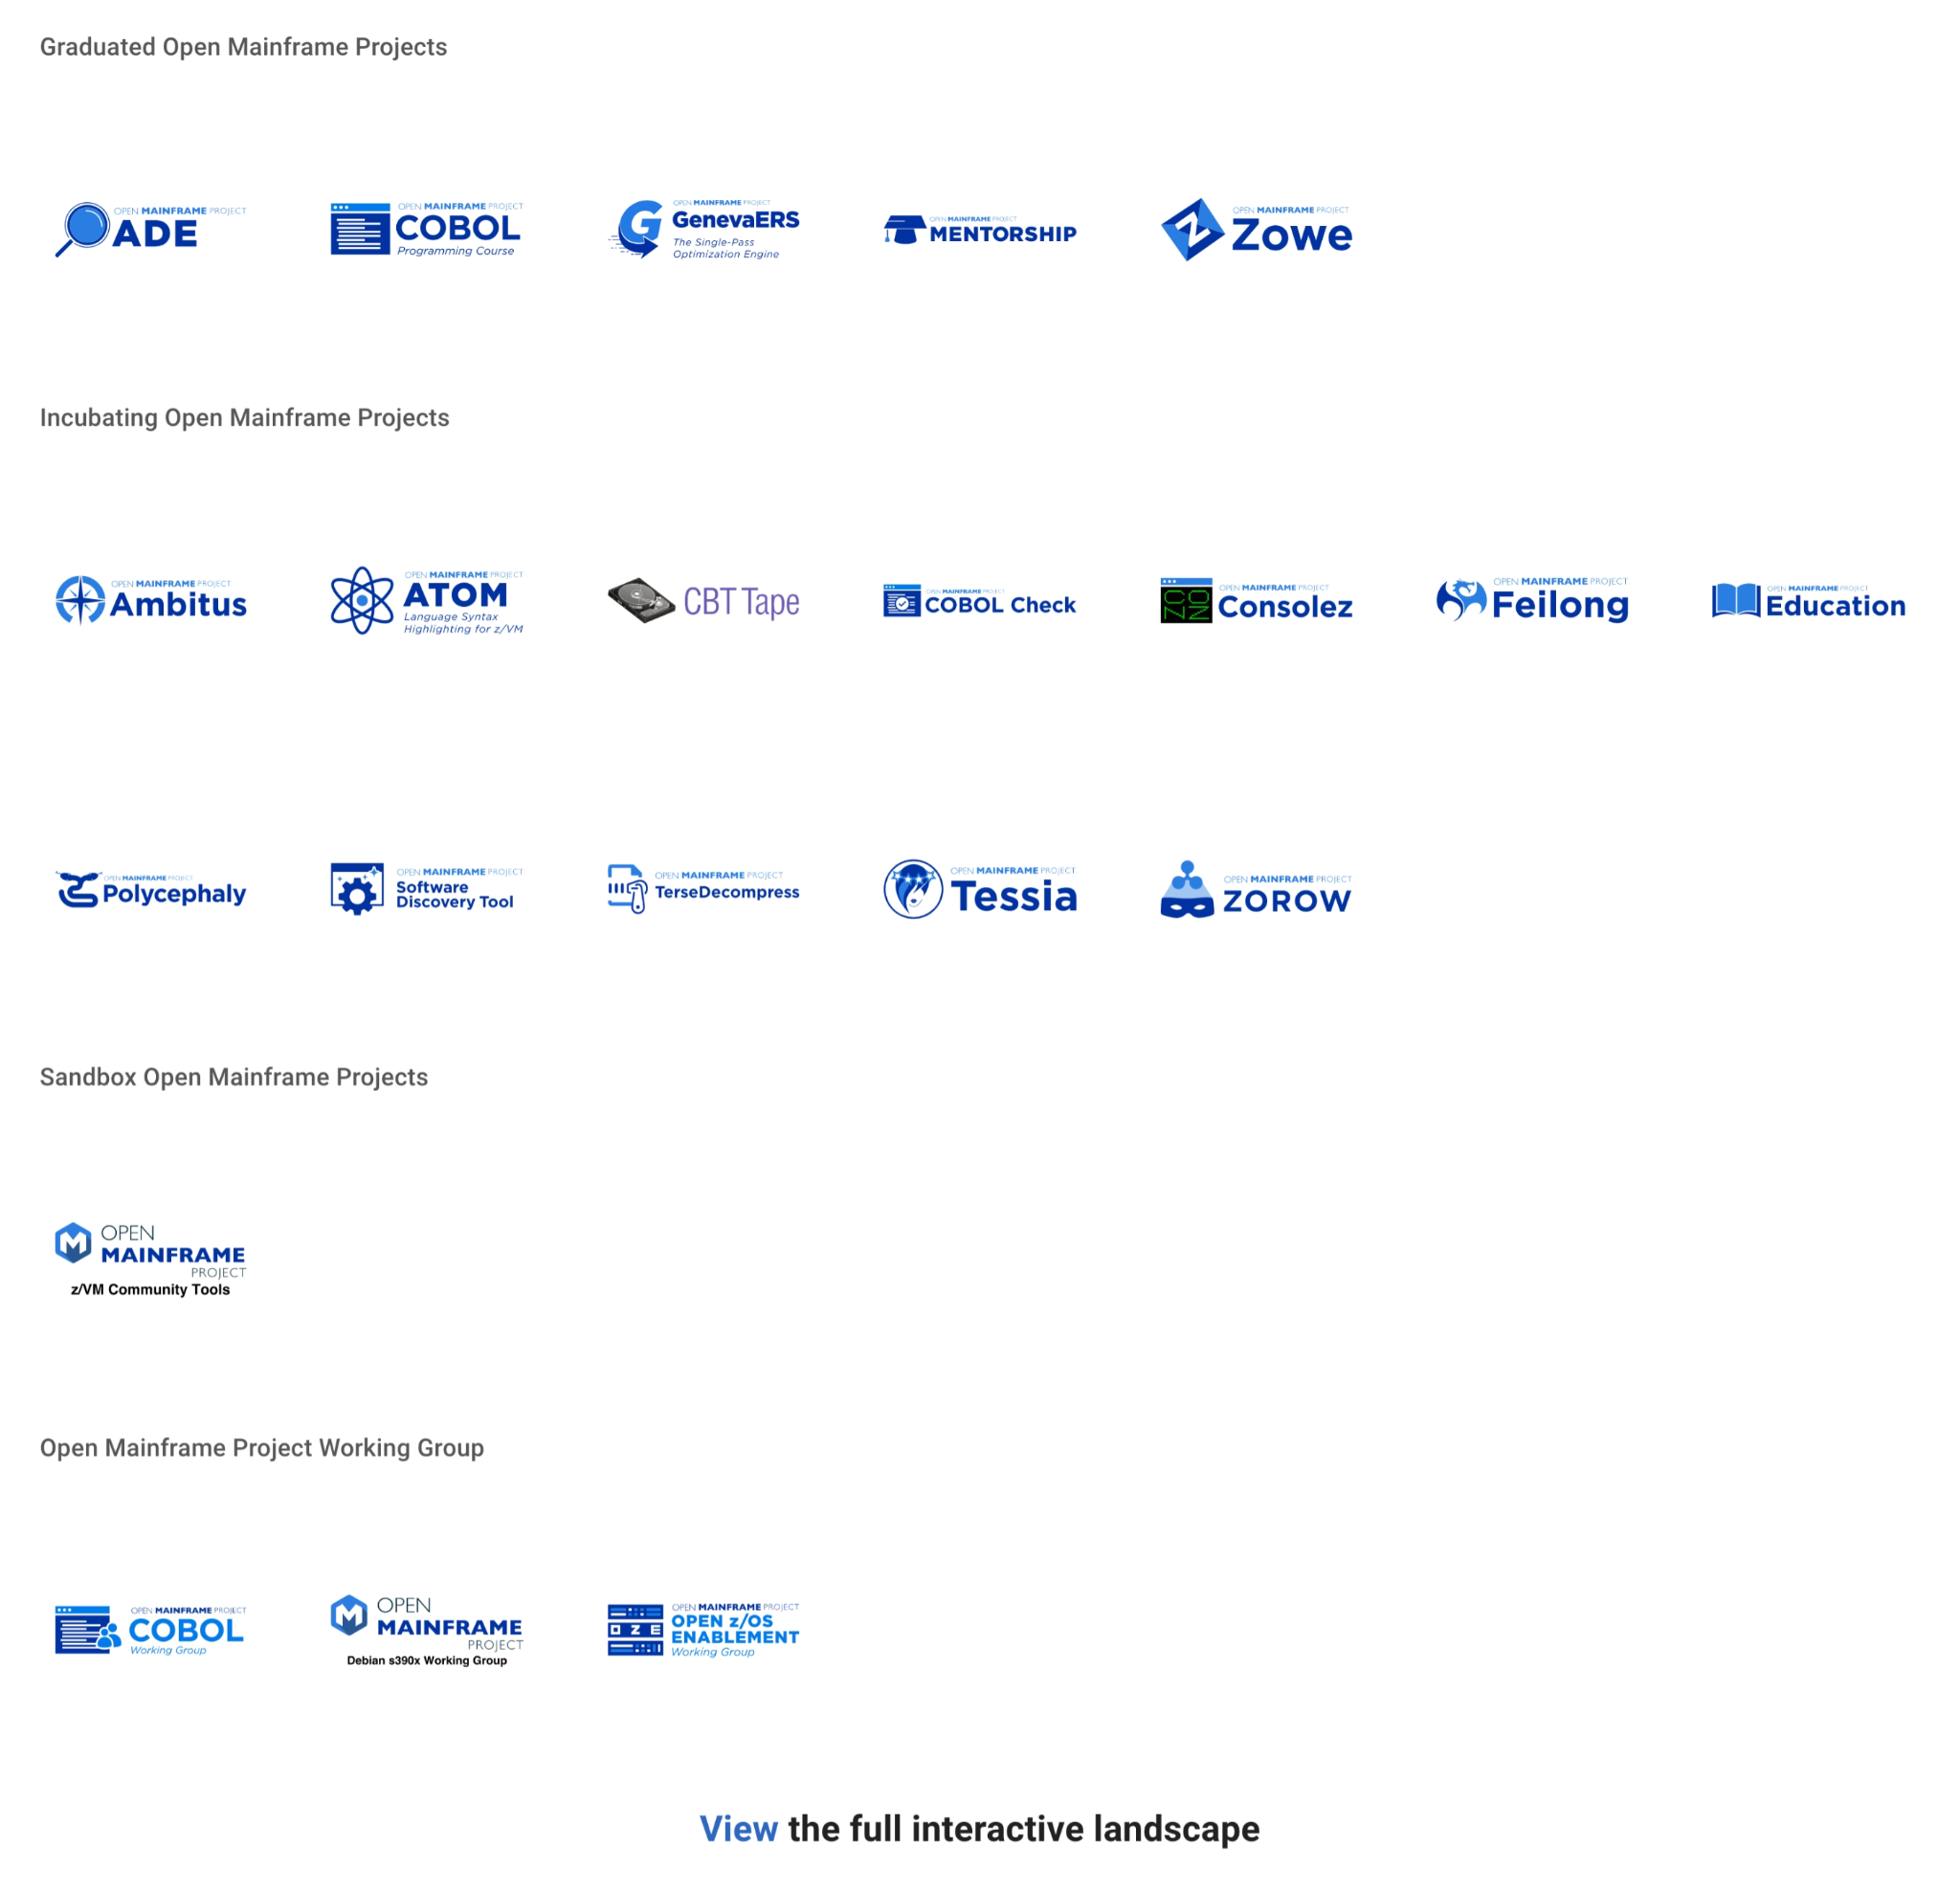
Open Mainframe Project enables this innovation
Learn about all Open Mainframe projects at https://www.openmainframeproject.org/projects
Notes:
Open Mainframe Project enables this innovation as a host of 18 projects and working groups that are part of closing the gap.
Source: https://landscape.openmainframeproject.org/pages/hosted-projects

Slide 11
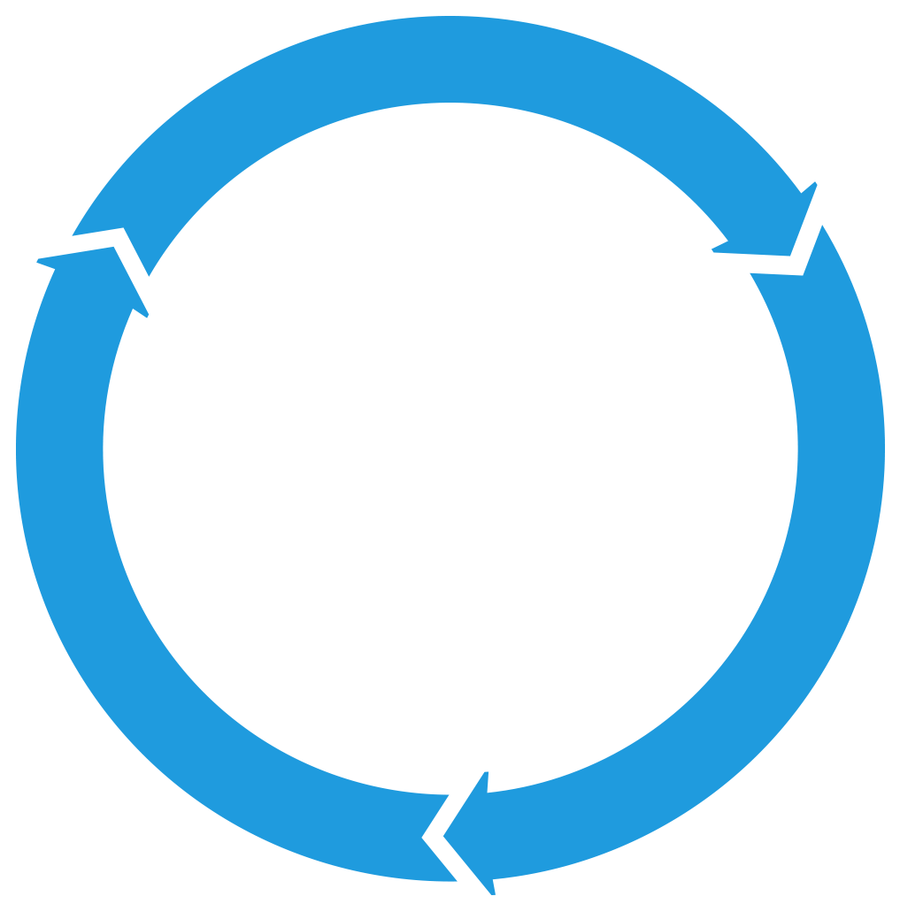

Most importantly, Open Mainframe Project sustainability enables this innovation
Successful projects depend on members, developers, standards and infrastructure to develop products that the market will adopt
PROJECTS
DEVELOPER
COMMUNITY
TECHNOLOGY
PARTICIPATION
MARKETS
PRODUCTS
PROFITS
PRODUCTS
Notes:
But most importantly, this is done sustainably. This means that the projects and working groups are structured and governed to drive forward for decades to come, using the same formula for success we’ve seen in over 450 open source projects hosted at the Linux Foundation.
(explain chart)

Slide 12

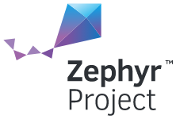
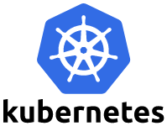
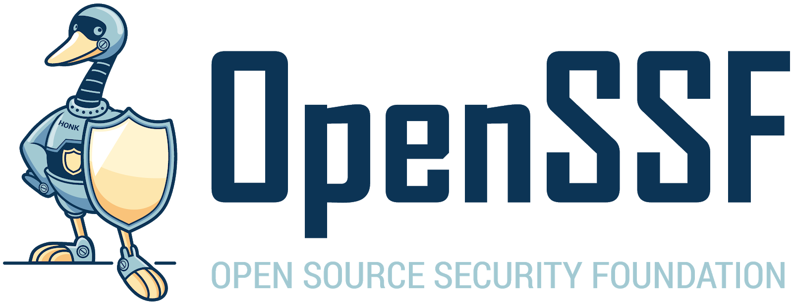


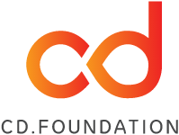
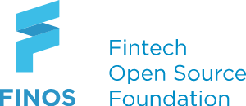

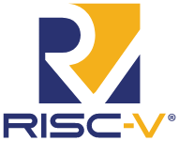
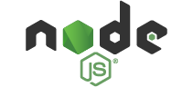
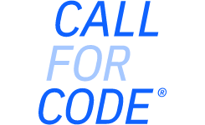


Open Mainframe Project: part of The Linux Foundation ecosystem of sustainable open source
For the last 16 years, The Linux Foundation has provided unparalleled support for open source communities through financial and intellectual resources, governance structure, IT infrastructure, services, events, and training.
Dedicated to building sustainable ecosystems around open source projects, The Linux Foundation is working with the global technology community to solve the world’s hardest problems through open source and creating the largest shared technology investment in history.
The Linux Foundation is the umbrella organization for more than 700 open source projects accelerating open technology development and commercial adoption. Some of the game-changing initiatives hosted by The Linux Foundation include:
Notes:
See more details here: https://www.linuxfoundation.org/join/#benefits

Slide 13
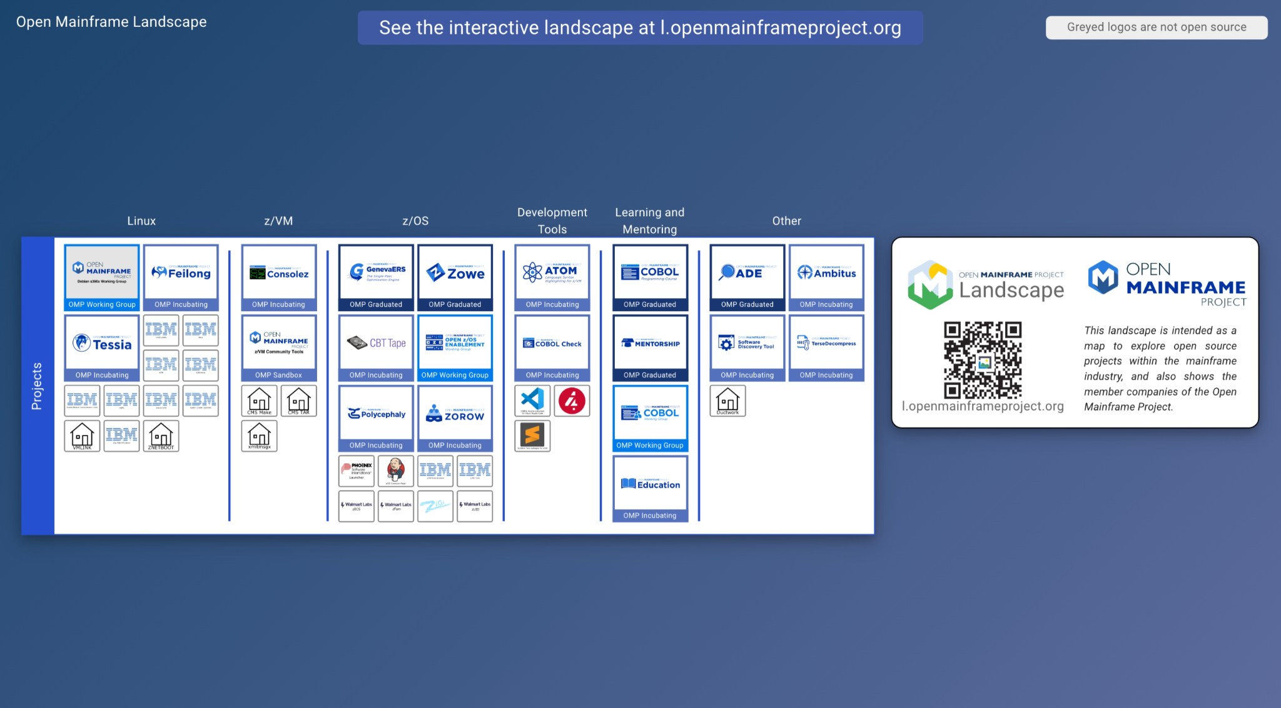
Notes:
The ecosystem of open source on mainframe continues to grow, thanks to the work of the open source community on mainframe.
Source: https://landscape.openmainframeproject.org/fullscreen

Slide 14
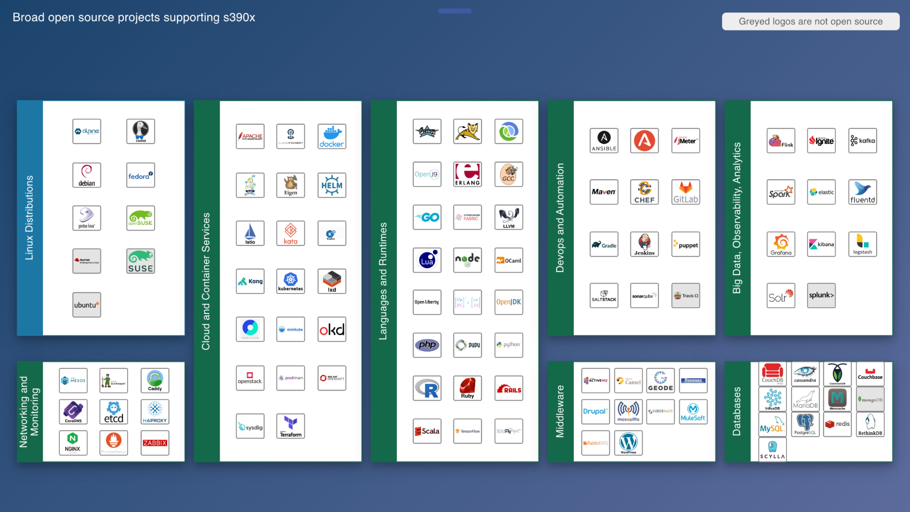
Notes:
Further, the open source community on mainframe is ensuring broad open source is supported on mainframe, which is the key piece for forward thinking organizations to realizing the mainframe’s benefits in their computing infrastructure.
Source: https://landscape.openmainframeproject.org/fullscreen/open-source

Slide 15

Enabling innovation - connecting z/OS to enterprise devops with Zowe
Major Problem
How OMP Innovated
Results - 2021
Modernize integration with z/OS based applications and services
Bridge the talent gap by enabling modern development stacks on z/OS
2018 Open Mainframe Project added Zowe from contributions from Broadcom, IBM, Rocket Software
2019 Zowe reached 1.0, launched Zowe Conformant to enable downstream ecosystem
Investments in collaboration, ecosystem development, and infrastructure
2021 Zowe formed TSC to have technologists lead project direction.
30000+ Commits, 250+ committers all time
Zowe gaining significant mindshare in DevOps community
50+ Zowe Conformant offerings from vendors Broadcom, IBM, MicroFocus, Phoenix Software International, Rocket Software, Software Engineering AG
2 Zowe Conformant Support Providers - Broadcom and IBM
New project contributions from BMC, IBA Group, Vicom Infinity, and others, has grown codebase
Notes:
Let’s see how this is happening today. Enter Zowe, the first open source project launched on z/OS.
Zowe is focused modernizing integration with z/OS based applications and services, and at the same time bridging both the talent and tooling gaps. Launched in 2018, Zowe is gaining mindshare in DevOps and being leveraged by forward thinking organizations globally, shifting the perception of mainframe from a “legacy” platform to a “growth” platform.

Slide 16
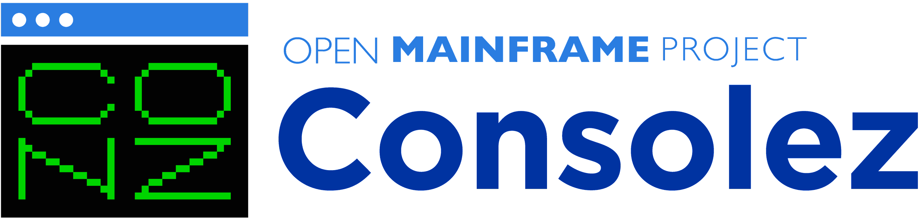

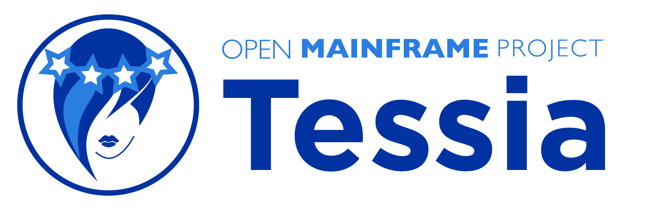
Enabling innovation - modernize z/VM integration with cloud technologies and deployment
Major Problem
How OMP Innovated
Results - 2021
Users want to manage their mainframes with the same modern cloud technologies used across the enterprise.
z/VM integration with technologies such as OpenStack have long been a challenge.
Contribution base was IBM only, making it challenging to get wider adoption
2019 Open Mainframe Project added Feilong
Feilong TSC elects co-chairs from SUSE and Velocity Software
2020 Tessia is added as a project
2021 Consolez is added as a project
ADP, SUSE, Velocity Software, Vicom Infinity, and ICU IT engaging in addition to IBM
New innovations and integrations being created in the community to upstream.
Projects running independently, but coordinating to ensure a streamlined solution.
Notes:
Linux has been part of the mainframe since 1999, which has enabled more and more workloads to shift to mainframe. While from a developer perspective, Linux on mainframe is just like Linux anywhere, there are key technologies such as z/VM which are native to the platform and key to having a unified DevOps approach.
These three projects, ConsoleZ, Feilong, and Tessia, all touch on parts of that story. In the past efforts like this had been driven within IBM, but with the launch of the Open Mainframe Project IBM and the community now have a space for collaborating with customers and vendors to drive an open source solution. In addition, all being a part of the Open Mainframe Project enables closer cooperation between projects.

Slide 17


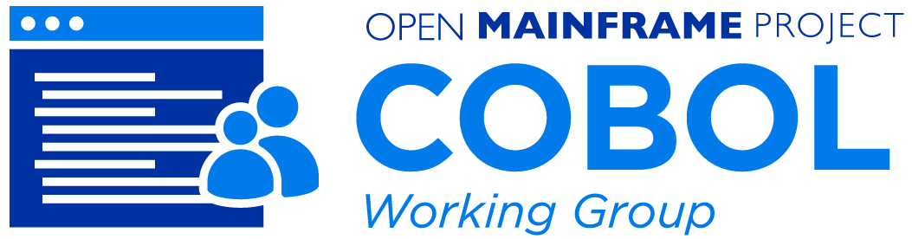
Enabling innovation - modernizing COBOL
Major Problem
How OMP Innovated
Results - 2021
COBOL talent is critical to our society, and the need has amplified in the COVID-19 pandemic.
Enabling the next generation to have COBOL skills done in isolation, causing repeated efforts and lower uptick.
COBOL lacking tools that align with modern development
Launched COBOL Programming Course as an open source project in April 2020
Created collaboration forums and ways that COBOL talent can advertise their availability
Launched COBOL Working Group to bring together leaders in thinking about the future of COBOL
COBOL Check project launched, bringing TDD practices to COBOL
“Calling all COBOL Programmers” forum has had over 1800 individuals make themselves available since April 2020
COBOL Programming Course has 1.9k stars and 400+ forks, along with 17 contributors from several organizations.
COBOL Working Group getting broad feedback on the future direction of COBOL
COBOL Check a step forward in modern dev practices
Notes:
COBOL hit our collective awareness in the early days of the COVID-19 pandemic, and is identified as a key technology empowering our society. While COBOL was a modern language decades ago, with it being disconnected from other language communities and COBOL skills not being in focus in education, there was a need to move it forward.
Mainframe is where the vast majority of COBOL code is deployed, so the Open Mainframe Project became the natural home for creating a vendor-neutral space for this community. Open Mainframe Project focused on projects that help bring COBOL forward, from the COBOL Programming Course which was launched in the early days of the COVID-19 pandemic and has help hundreds learn COBOL using the development tools of today, to the COBOL Check project that is bringing TDD practices to COBOL development. In addition, thought leader is being driven in the COBOL working group that is aiming to continue pushing COBOL forward.

Slide 18

Enabling innovation - with the next generation
Major Problem
How OMP Innovated
Results - 2020
Aging tenured mainframe talent, with a growing mainframe talent gap and skills decline in next generation talent.
Needing to help connect students with opportunities in mainframe, aligning the interests in open source
Launched first mentorship program in 2016 with 7 mentees.
Connected within the mainframe and broad open source community to ensure mentorship work has upstream project value.
Enabled universities to also leverage the program within class work; successful with VCU and Western University (Ontario)
40+ mentees completed the program, with broader classwork focus reaching 100+ more.
Upstream work has included ports of Alpine Linux, contributions to HyperLedger, OpenStack, CloudFoundry, Kubernetes, and more.
Several mentees are now employed in mainframe roles with IBM, SUSE, ADP, and more.
Notes:
The mentorship program was started in 2016, and has brought an influx of students and new open source code into mainframe. It has also helped companies find talent, and academic institutions showcase talent to organization looking to hire.

Slide 19

Open Mainframe Project enables innovation through community building
Notes:
Code is not the only way innovation happens. Open Mainframe Project believes in community, and as part of it’s mission creates space and opportunity for that community to grow and thrive.

Slide 20
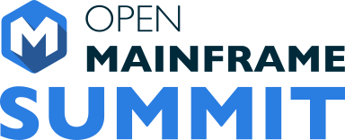
A Focal point for open source on mainframe
Open Mainframe Summit is the annual event that brings together the open source and mainframe ecosystems, discussing projects, trends, and executive insights.
September 21 – 22, 2022
Philadelphia, PA
https://events.linuxfoundation.org/open-mainframe-summit-2022

Slide 21
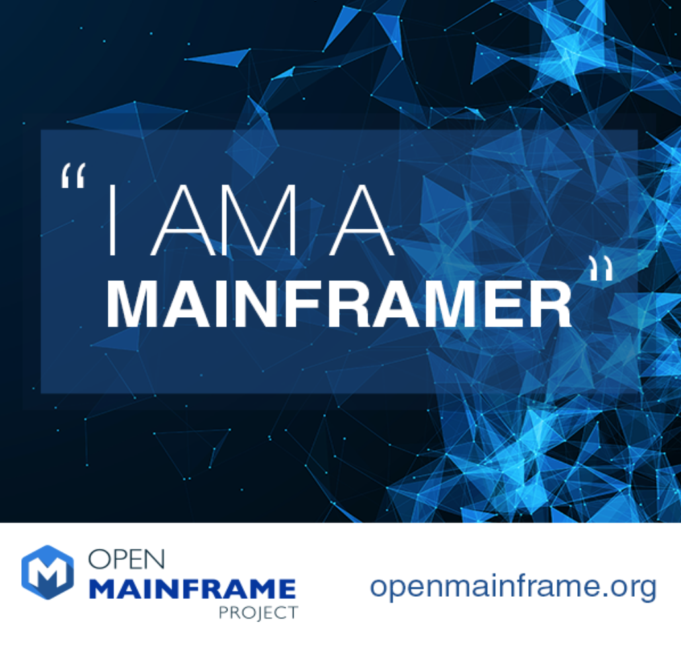



Telling the “mainframer” story
Monthly interview series that highlights diversity in mainframe
Showcases why people have mainframe in their careers and their views of the technology and career field
Read and listen at https://www.openmainframeproject.org/news/podcast
Notes:
One key way is through our podcast, “I Am A Mainframer”, which showcases those in this industry from all races, genders, ages, and locales, highlighting the diversity in mainframe and providing insight into where people in this community see the mainframe ecosystem going.

Slide 22

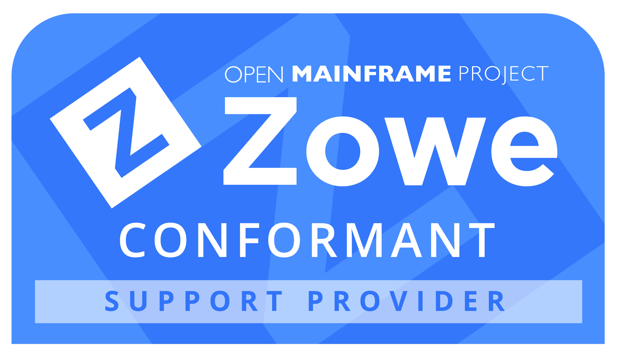
Building an ecosystem through Zowe Conformance
Zowe Conformance Program enables vendors to showcase their offerings based on Zowe, as well as their capabilities in supporting Zowe end-users.
Zowe Support Provider Conformance Program gives vendors the ability to showcase their Zowe support competencies.
Benefits
Your offering and logo listed in the Zowe Conformant offering directory or Zowe Conformant Support Provider directory and showcased in Zowe outreach materials
Exclusive branding marks to use in your product materials
Participation in the Zowe Advisory Council (ZAC)

Slide 23
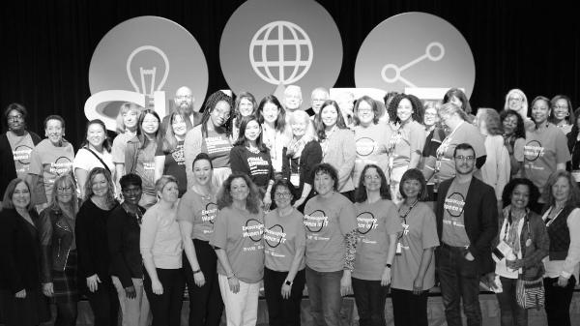
Growing diversity in mainframe

Slide 24
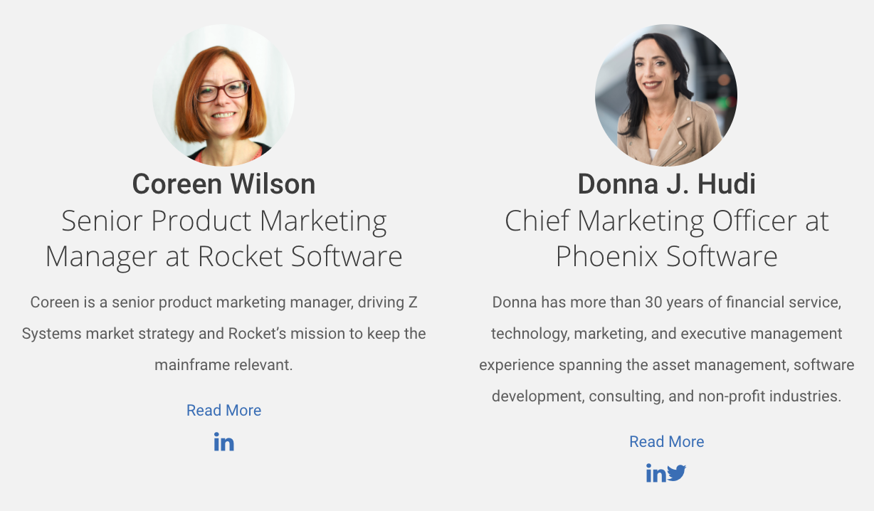
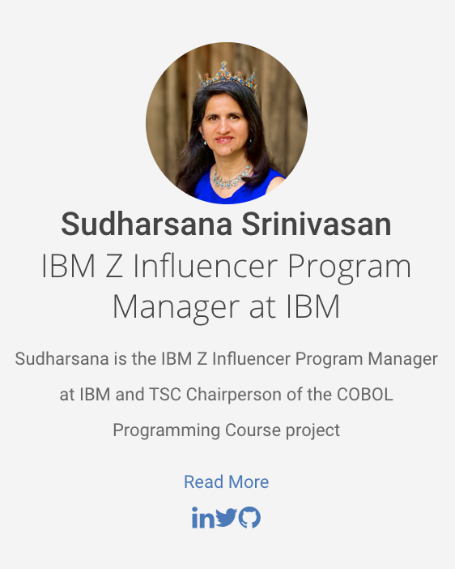
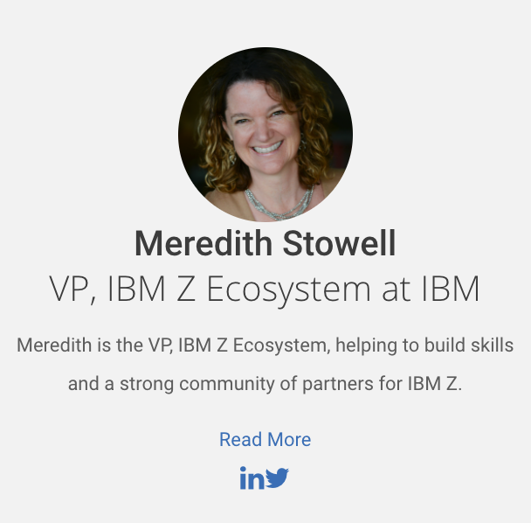
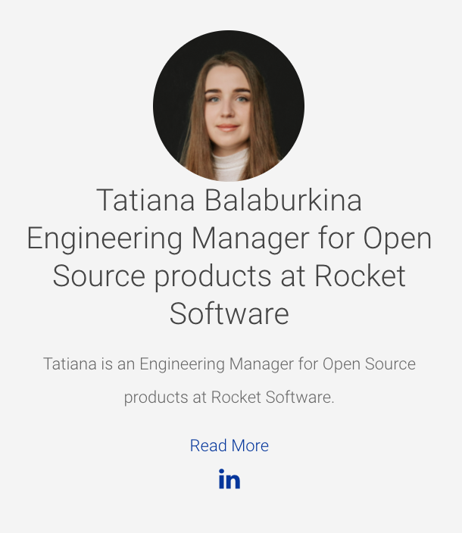
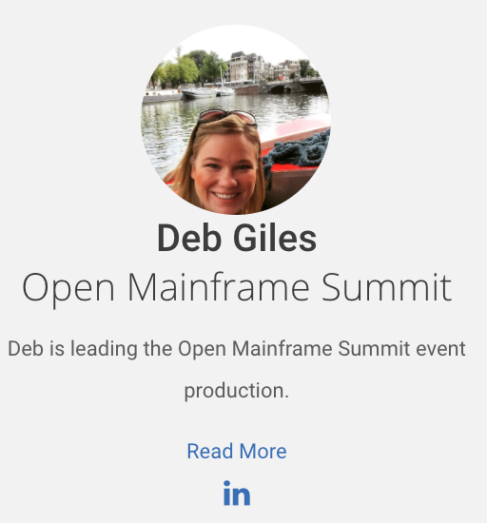
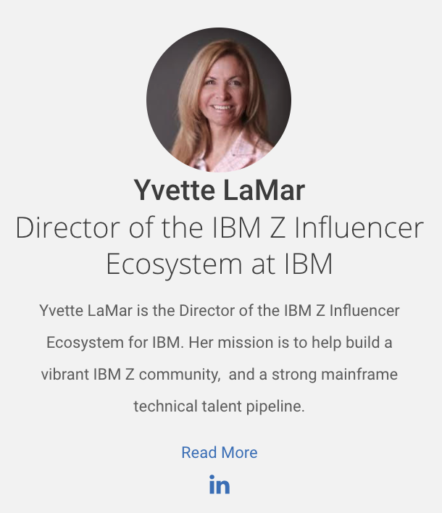
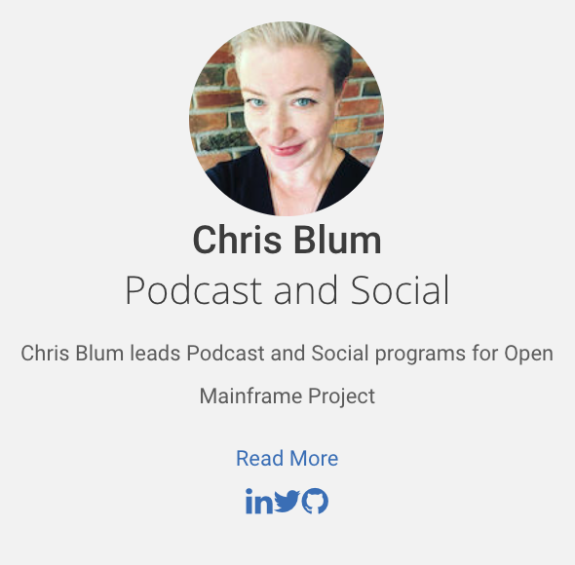
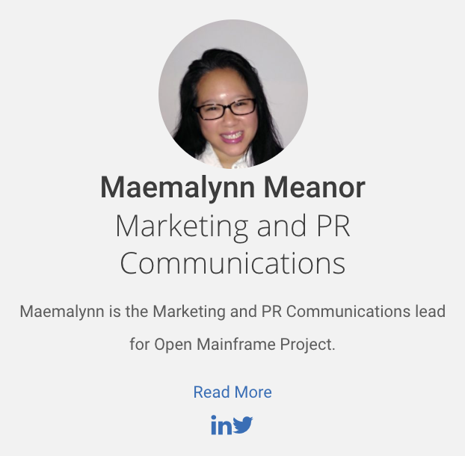
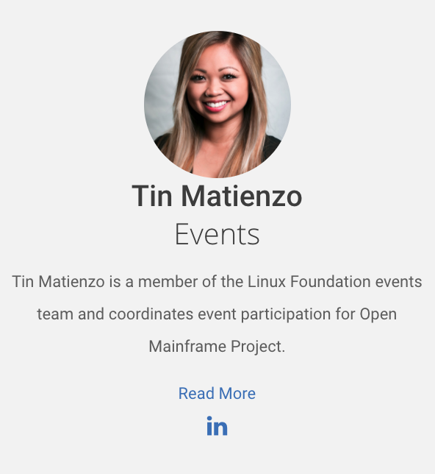
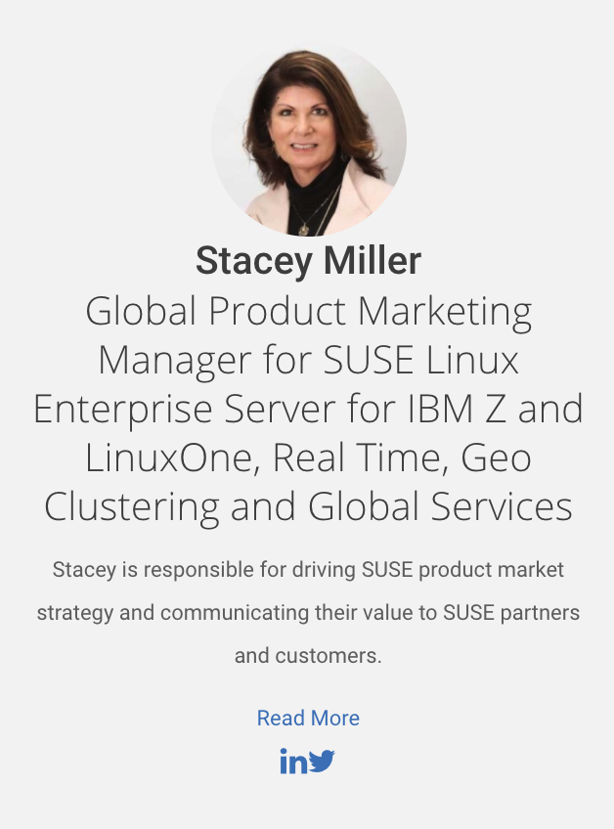
Open Mainframe Project Female Leadership
Over 35% of Open Mainframe Project Leadership is Female

Slide 25
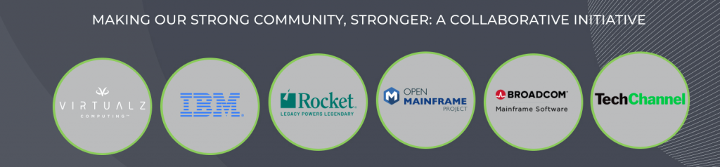
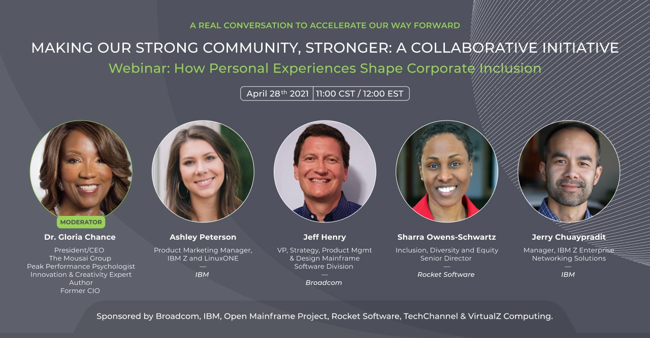
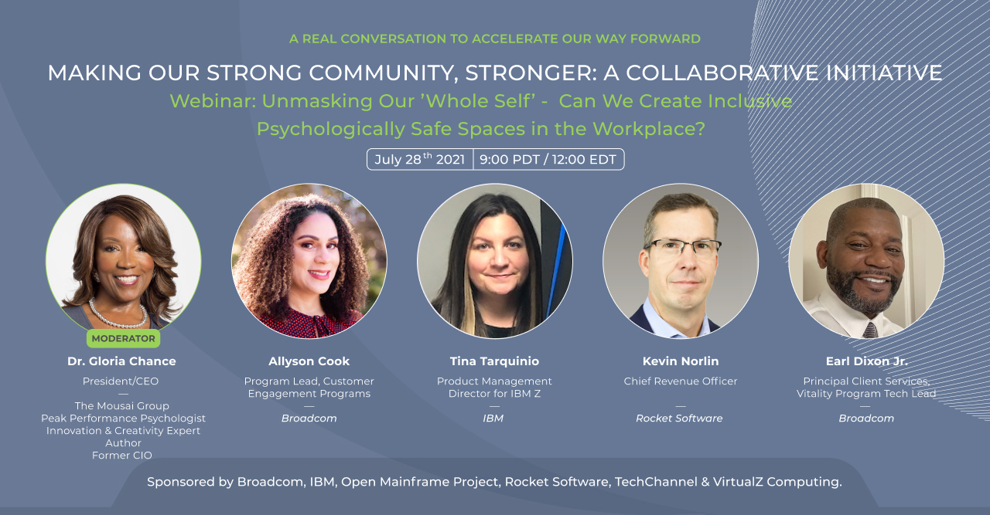
Watch the videos on Open Mainframe Project’s Youtube Channel

Slide 26

Building a diverse and inclusive community
The Open Mainframe Project promotes diverse and inclusive communities, partnering with groups and efforts to increase diversity in mainframe.
Check out our Diversity and Inclusion working group at https://lists.openmainframeproject.org/g/wg-diversity and events at https://www.openmainframeproject.org/events/category/diversity-inclusion

Slide 27
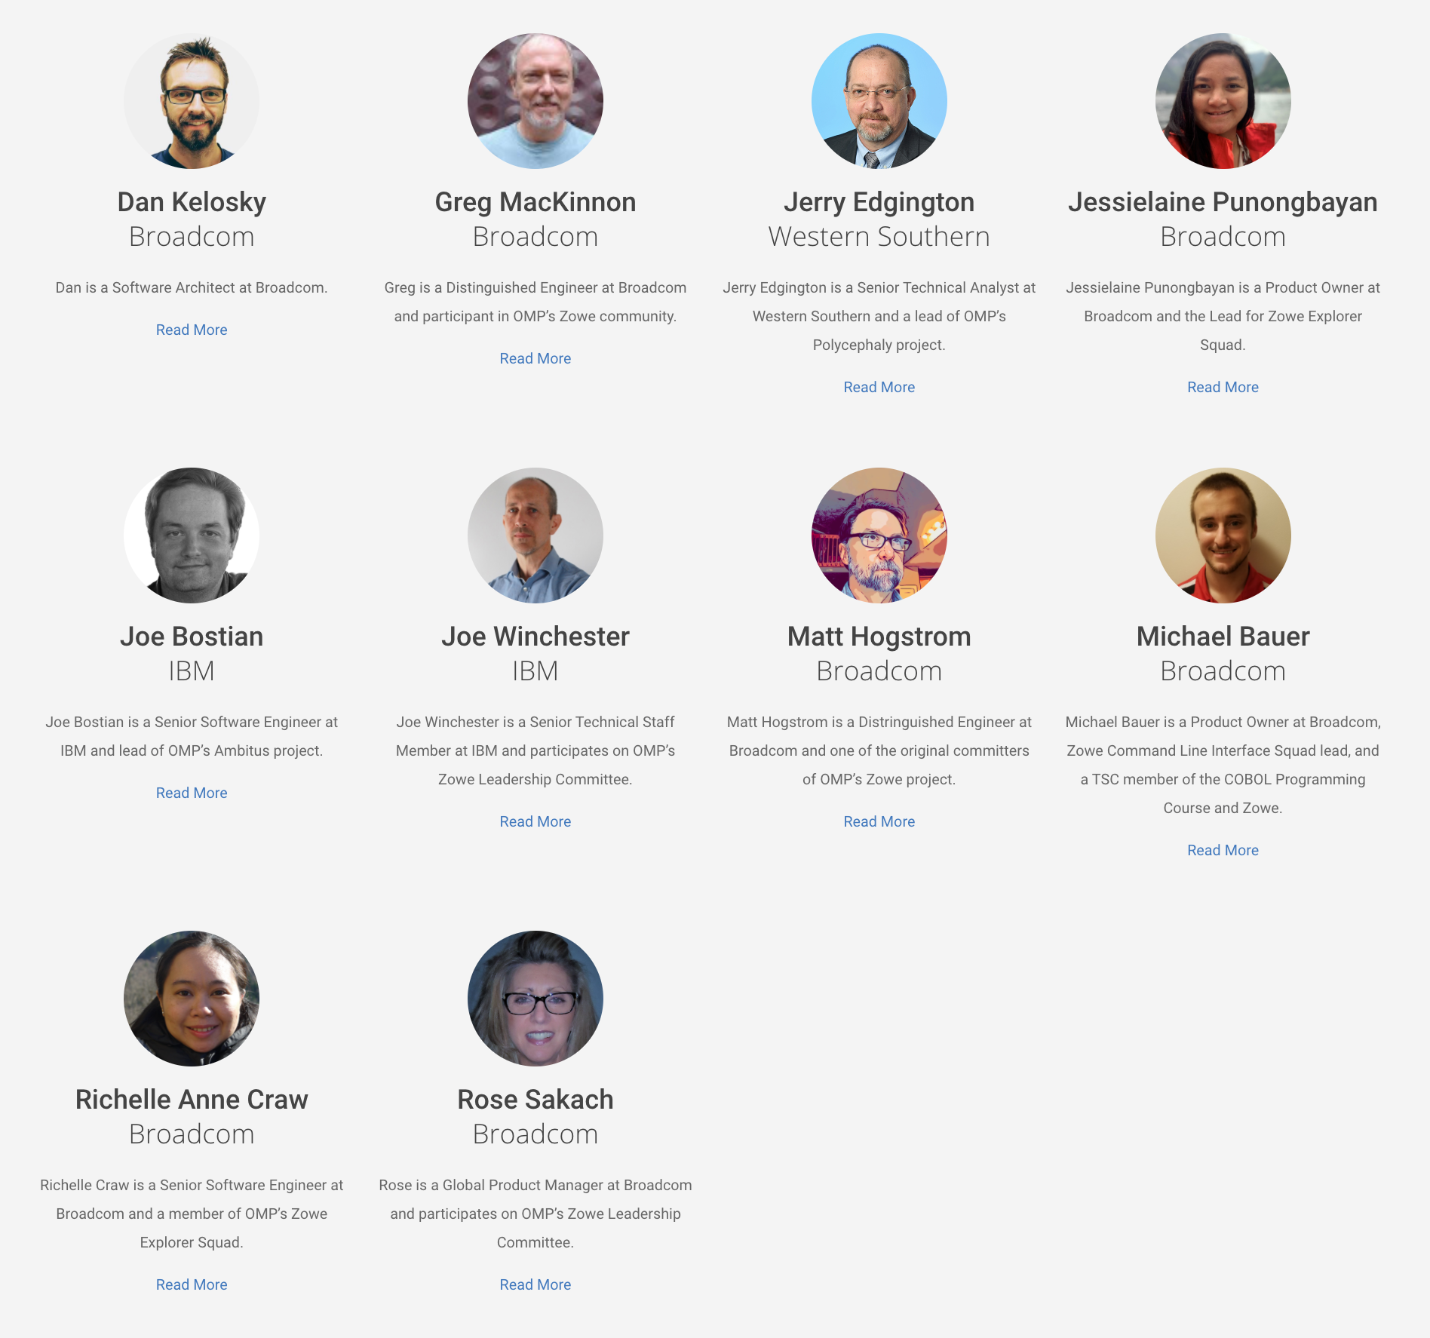
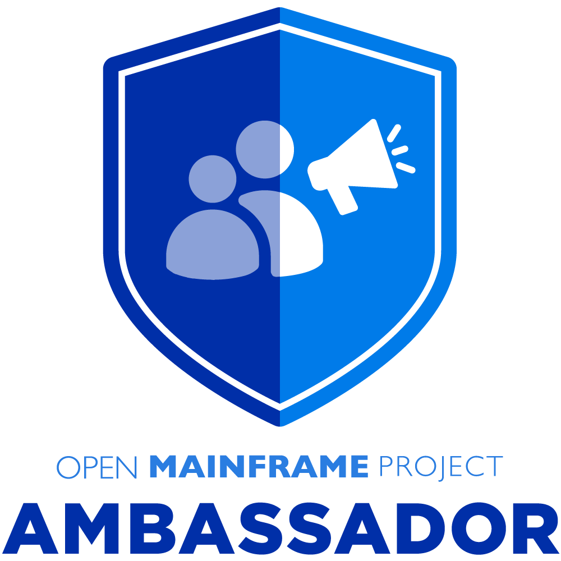
OMP Ambassadors driving awareness
Open Mainframe Project Ambassadors are individuals who are passionate about the mainframe technology, recognized for their expertise, and willing to help others learn about it and community. Successful ambassadors are people such as bloggers, influencers, evangelists who are already engaged with an Open Mainframe project in some way including contributing to forums, online groups, community events, etc.
If you would like an ambassador to speak at your event, please contact pr@openmainframeproject.org with the name of the conference, date and links.

Slide 28
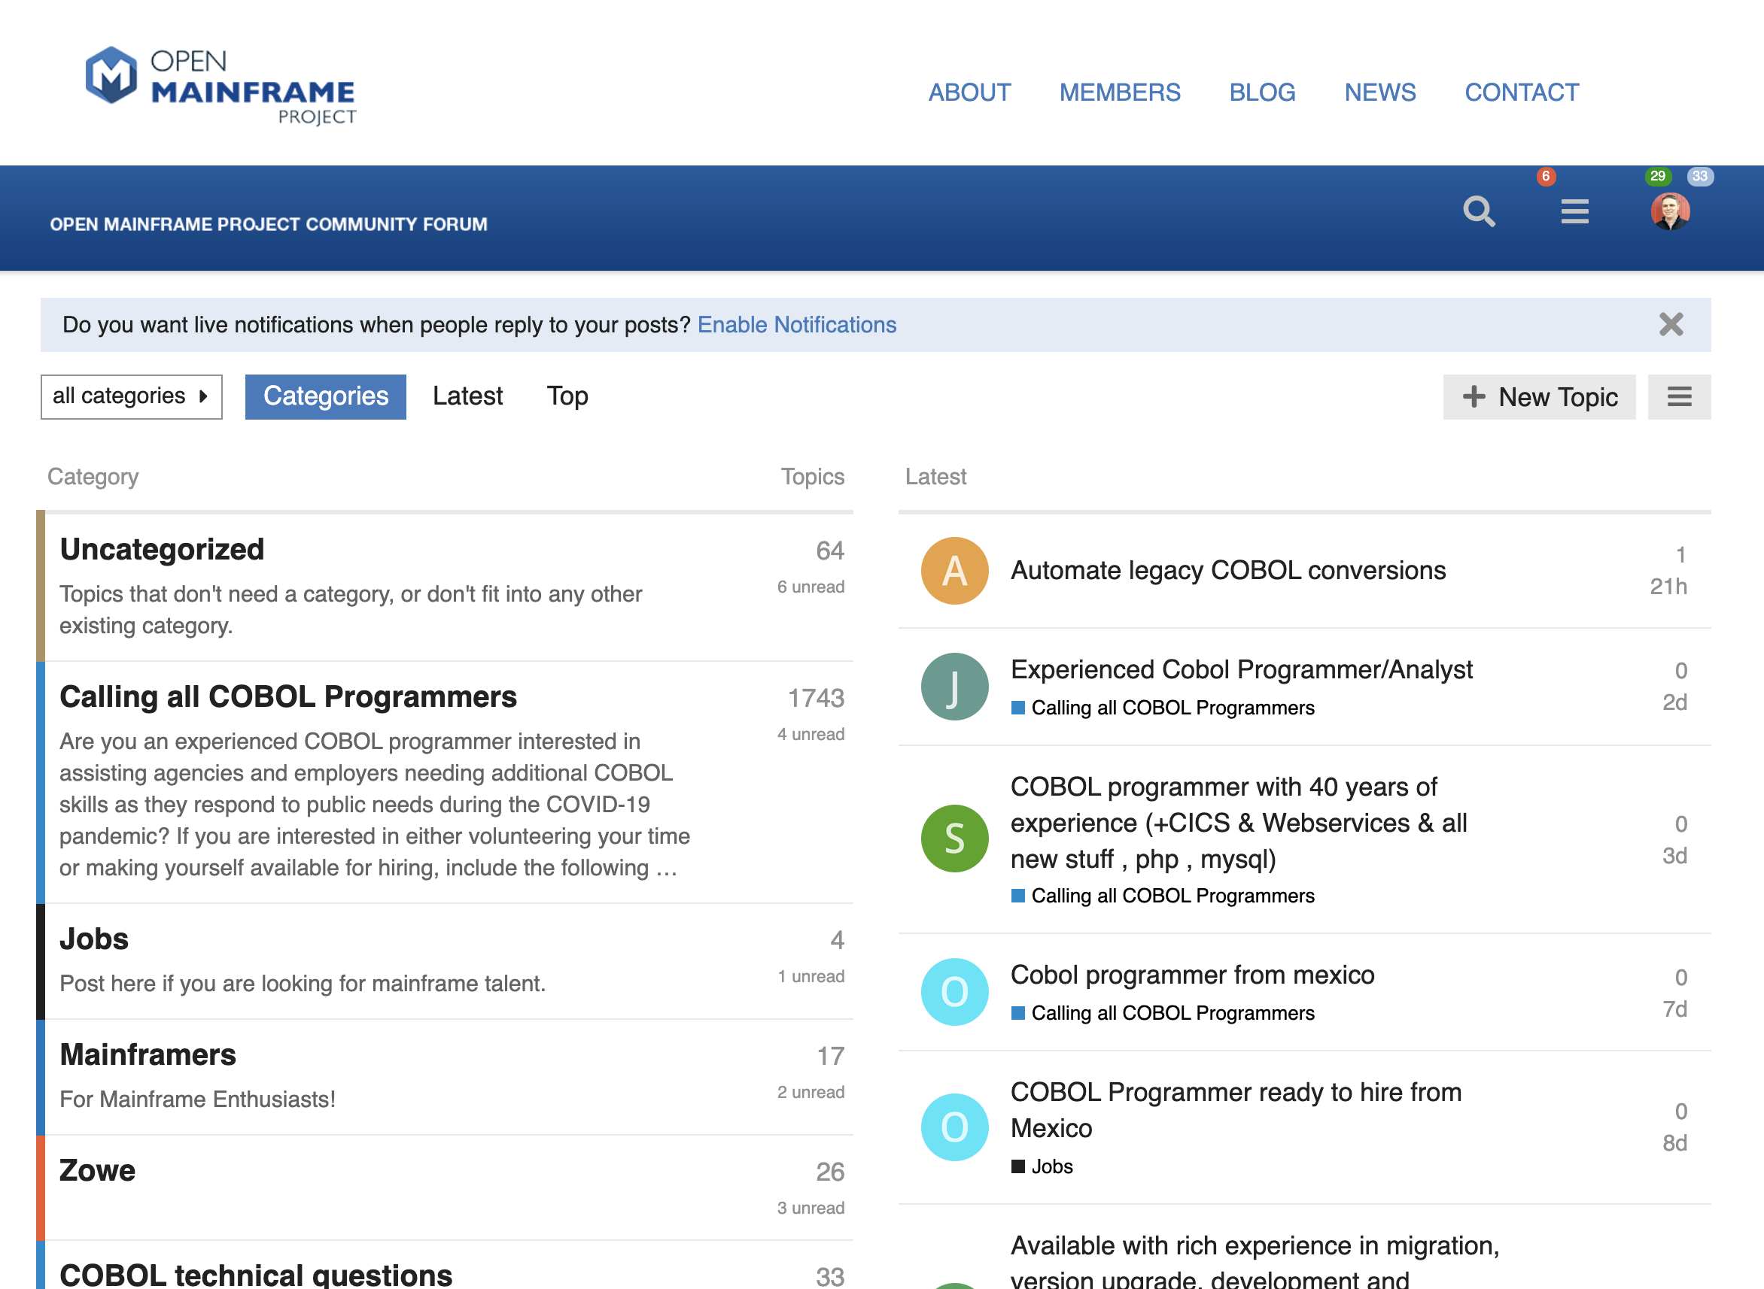
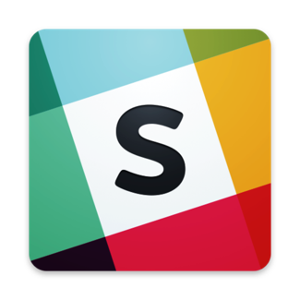
Bringing together the open source and mainframe conversation
Slack Channel
https://slack.openmainframeproject.org
Community Forums
https://community.openmainframeproject.org/
Notes:
Open Mainframe Projects hosts community collaboration platforms, is a part of key industry events, and hosts the annual Open Mainframe Summit to bring together the open source on mainframe community.

Slide 29
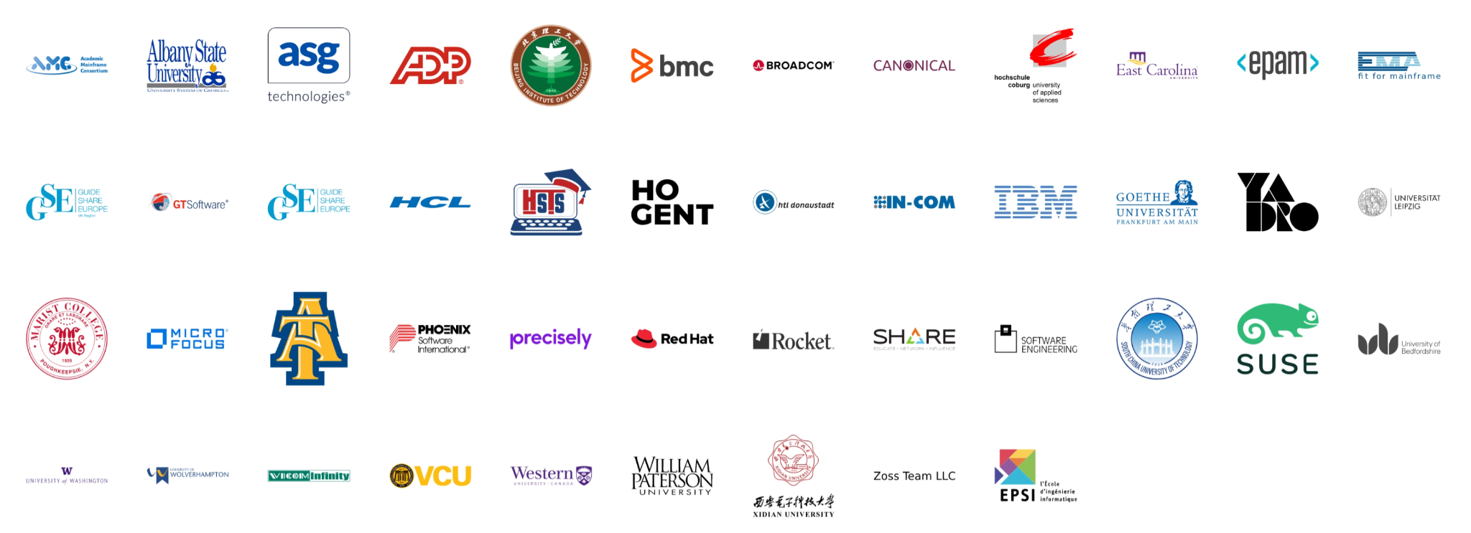
6 years since launch | 46 Supporting Organizations | 20 Hosted Projects and Working Groups | 40+ Mentees Sponsored | 1000+ Project Contributors | 61,000+ Project Contributions
Notes:
In over 5 years, the project has seen tremendous growth by tripling members since launch and growing from 1 project to 18, making huge impacts on the open source on mainframe ecosystem.
Source: https://landscape.openmainframeproject.org/pages/members-not-grouped

Slide 30




How to participate in Open Mainframe Project
Open participation for all interested in Mainframe and Open Source
Join the community discussion via communication channels, social, and at events
20 Shared R&D open source projects and working groups - or bring your project to be hosted here
Corporate sponsorship for showing stewardship in the community
https://www.openmainframeproject.org/about/join
‹#›
Notes:
Anyone may participate; the Open Mainframe Project encourages companies to become sponsoring participants and support the mission of the Open Mainframe Project.

Slide 31


Make sure you are following us on social!
Follow us on LinkedIn at https://www.linkedin.com/company/the-open-mainframe-project
Follow us on Twitter at https://twitter.com/OpenMFProject
And sign up for the Open Mainframe Project newsletter to keep up to date on project happenings

Slide 32


Learn more about the Open Mainframe Project
Find out more at openmainframeproject.org
See the breadth of open source on the mainframe at l.openmainframeproject.org
Discover and participate in any of our 20 hosted projects and working groups at openmainframeproject.org/projects
Take part in our upcoming events and webinars at openmainframeproject.org/events
Notes:
You can get involved and learn more by...

Slide 33
Thank you!

Slide 34
Endnotes
Slide 2, image from https://www.flickr.com/photos/boston_public_library/6280049616/
Slide 3, image from https://nara.getarchive.net/media/data-processing-technician-2nd-class-holt-monitors-a-telecommunications-console-4db71d
Slide 18, image from https://pxhere.com/en/photo/1432563

Slide 35
Why become a member?

Slide 36
Becoming an Open Mainframe Project member means your organization is...
a leader in the open source on mainframe community
wants to drive the technical vision of open source on mainframe
a thought leader or aims to be a thought leader in open source on mainframe
bringing solutions to market based on projects hosted at the Open Mainframe Project, and wanting to show your stewardship towards those communities

Slide 37



Leverage our industry presence to advance your thought leadership.
Through our large audience, extensive media outreach, and with key partnership with publications such as Linux.com, TFiR, TechChannel, and MediaOps, you will be positioned to be a thought leader in open source.
We also support member announcements with social outreach and quotes from John Mertic as appropriate.
4300+ followers
2600+ followers
1350+ shares in 2020
900+ global media articles in 2020 from 5 press announcements

Slide 38
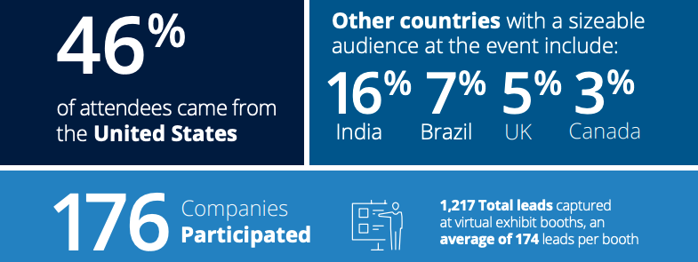
Be a part of Open Mainframe Summit
Open Mainframe Summit is the premier event focusing on the intersection of open source and the mainframe, bringing together thought leaders, executives, practitioners, and developers.
Learn more about the 2020 event in the Open Mainframe Summit Transparency Report 2020.
Open Mainframe Project members receive discounts on sponsorship at Open Mainframe Summit - contact us to learn more!
Stats from 2020 event

Slide 39
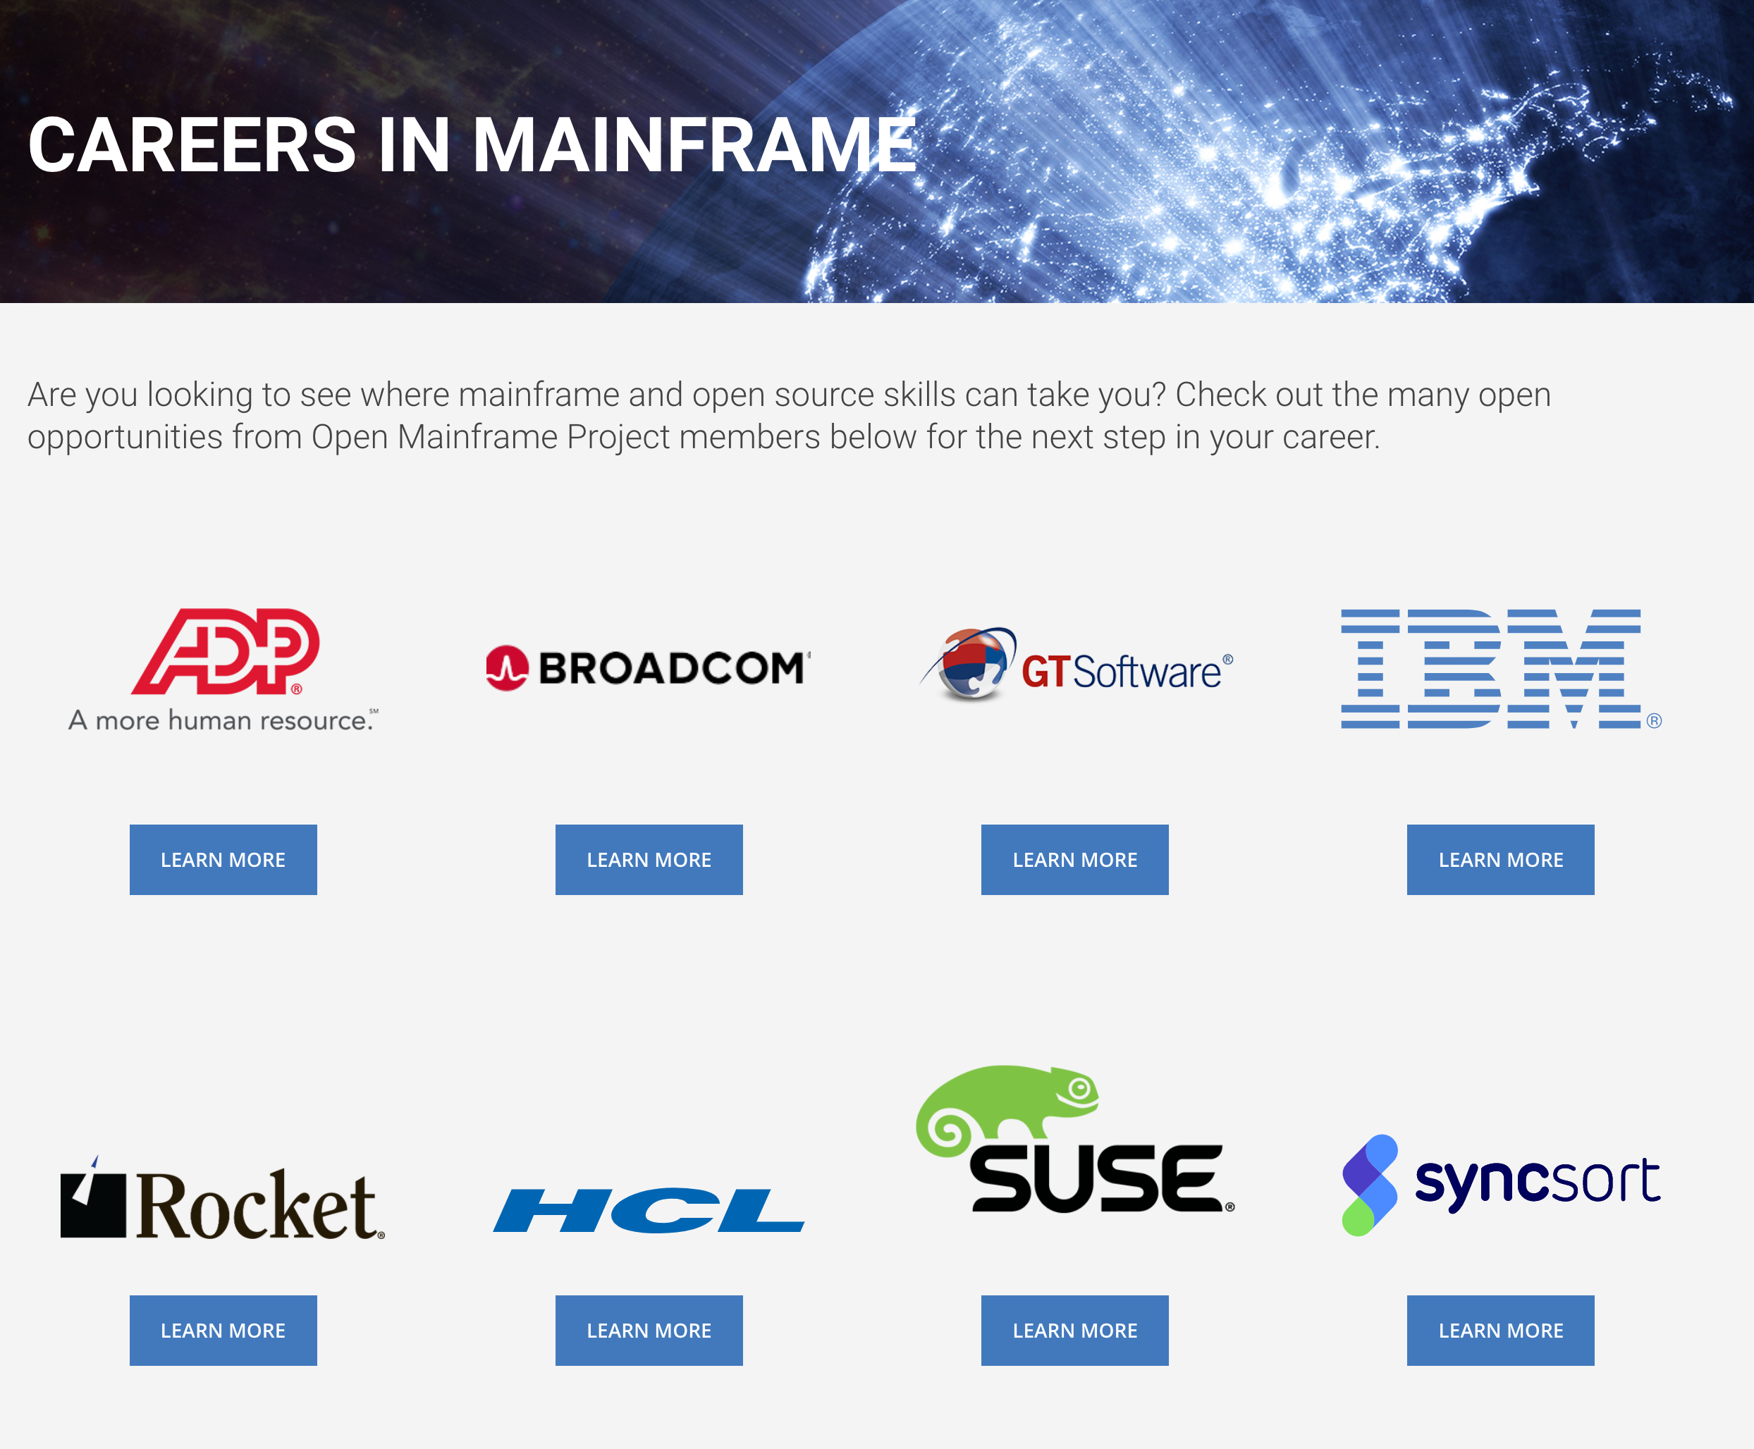
Showcase your career opportunities in Mainframe
Have your organization showcase to those coming to the Open Mainframe Project on members looking to hire.
Not a job board - links to each member’s job listings.

Slide 40
Zowe Conformance Program
Zowe Conformance Program enables vendors to showcase their offerings based on Zowe, as well as their capabilities in supporting Zowe end-users.
Zowe Support Provider Conformance Program gives vendors the ability to showcase their Zowe support competencies.
Benefits
Your offering and logo listed in the Zowe Conformant offering directory or Zowe Conformant Support Provider directory and showcased in Zowe outreach materials
Exclusive branding marks to use in your product materials
Participation in the Zowe Advisory Council (ZAC)
Fees are waived for Open Mainframe Project members
More details at https://www.openmainframeproject.org/projects/zowe/conformance

Slide 41
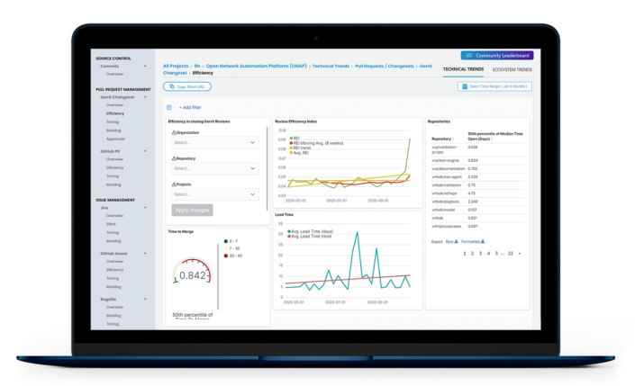

Measure your project impact with LFX Insights
LFX Insights (Technical Trends) is a new analytics tool that is provided to all open source projects hosted by the Linux Foundation. Its capabilities include:
Getting the visibility you need to remove bottlenecks at any stage of your project’s code pipeline. Drill down into performance metrics across every step in the development lifecycle to identify where you should be focusing your resources.
Ensuring the health and viability of the open source projects you care about. Leverage data to help validate projects for investment, and track the activity and growth of projects your organization is already involved in.
Showcasing your organization’s leadership and subject matter expertise in the open source community. Leverage affiliations to measure the impact of your employees’ contributions and capture the full picture of your team’s impact
In addition to the use of the other LFX tools provided by the Linux Foundation, access to LFX Insights (Ecosystem Trends) tool is available to Open Mainframe Project Silver and Platinum members, which provides additional visibility into tracking your project’s performance beyond code with a more holistic view of your ecosystem. Identify opportunities to grow your community and increase awareness with ecosystem trend metrics including share of voice, top influencers, email list collaborators, and more.

Slide 42

Maximize Your Open Source Investment with training credits
The Linux Foundation offers training and certification direct from the source, those contributing to the world’s most important open source projects.
As an Open Mainframe Project Silver or Platinum member, you are entitled to 10 vouchers for 100% any…
LF eLearning Class
Certification Exam
eLearning+Certification Exam “Bundle".
The value is $299+ per course.

Slide 43
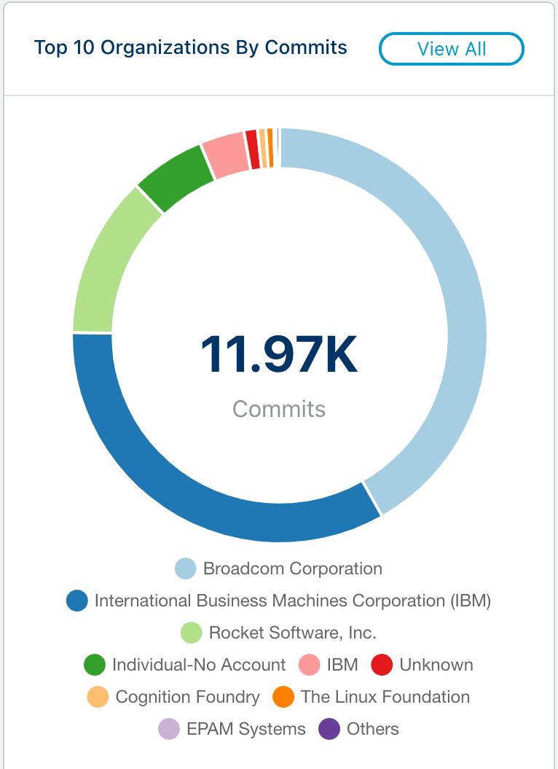
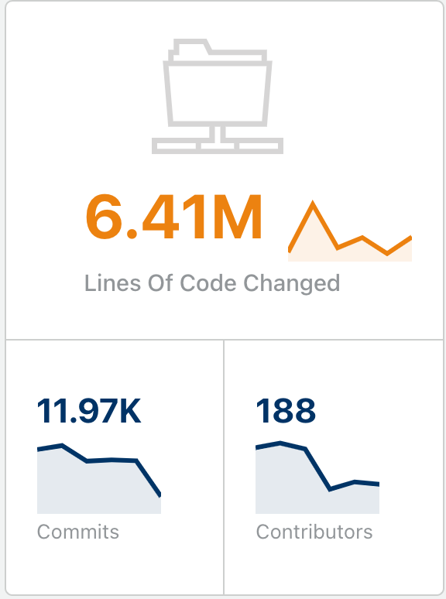
But most importantly, you support innovation
20 collaborative projects and working groups are successful because of the investment of members funding these initiatives.
Stats for 2020 listed at left

Slide 44
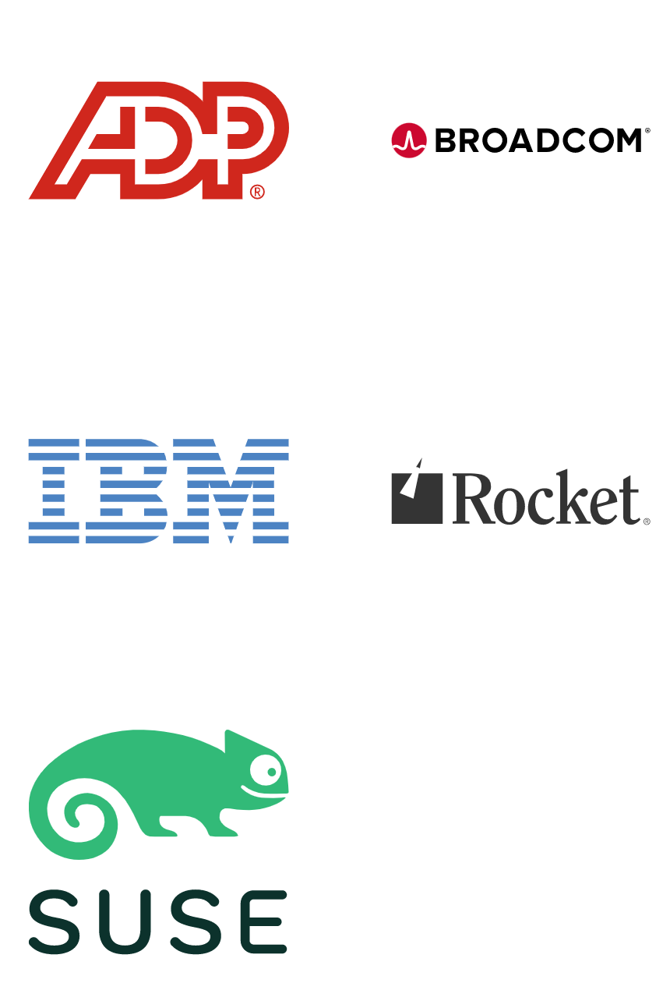
Drive the direction of the foundation through Platinum Membership
Platinum members are the key stewards of the Open Mainframe Project, and as such hold key leadership positions in the various governance structures. Their investment is key to the sustainability of open source in mainframe.
Specific Benefits include:
Voting seat on the Governing Board, TAC, and Marketing Committee, enabling the member to direct the strategic direction, budget, and priorities of the Open Mainframe Project.
Host an Open Mainframe Project webinar and have a guest on the “I Am A Mainframer” podcast annually, if desired.
Monthly meetings to brief on project activities, and an annual membership check-in to review engagement opportunities and provide feedback to project leadership.
First opportunity to participate and drive event and outreach opportunities, and the project will ensure partnership with Platinum Members in relevant events.
Open Mainframe Project leadership will support Platinum Member events, internal open source program efforts, and be available for customer and prospect engagement.

Slide 45
And more benefits from your Linux Foundation membership
Your contributions and support help the Foundation to provide its supporting programs that enable its many hosted open source project communities to thrive. In addition to the opportunities presented by networking, learning, and working with other member organizations that are using and contributing to Linux Foundation open source projects, there are many other benefits associated with a membership that include Marketing, Training, and Event opportunities. Silver Membership benefits include...
More details at https://linuxfoundation.org/en/join/#benefits. Let us know how we can help connect you to these opportunities! Sign up for the Linux Foundation newsletter to keep on top of the activities across our 350+ hosted projects.
Events Benefits
One invite to our member-exclusive Linux Foundation Member Summit, which fosters collaboration, innovation, and partnerships among the leading projects and organizations working to drive digital transformation with open source technologies.
Employees at your organization receive a 20% registration discount to eligible Linux Foundation events.
A 5% Discount on Linux Foundation Event Sponsorship (7% discount on multi-event Sponsorships). Sponsorships offer a valuable way to reach the community of Open Source Developers, Engineers, C-level Executives, and more.
Training Benefits
Ten coupon codes good for any eLearning, certification exam, or eLearning/exam bundle. Additional terms apply.
Legal Benefits
Your legal counsel’s ability to participate in bi-monthly legal calls
One invite for your in-house counsel to LF Legal Summit, which helps connect your counsel to their peers at other member companies and advance your organization’s open source licensing, litigation, compliance, and best practices.
Marketing Benefits
Your company logo on the LF website
Post one technical article about an open source project you care about to Linux.com, which has over 1 million unique visitors per month.
Exposure through new Silver members group press release, with social media promotion.
Have your company’s events featured on our events.linuxfoundation.org community events calendar

Slide 46
Corporate, Academic, Associate Membership Levels
Level | Annual Fee | Board Seat | TAC Seat | Marketing Committee | Notes
Platinum | $120,000 | Yes | Voting | Yes | Initial 2-year participant commitment
Platinum End-User | $30,000 | Yes | Voting | Yes | Initial 2-year participant commitment
Silver | 5,000 employees or more = $50,000 2,000 < 5,000 employees = $35,000 1,000 < 2,000 employees = $30,000 500 < 1000 employees = $25,000 100 < 500 employees = $15,000 < 100 employees = $10,000 | 1 per 10 | Non Voting | Yes
Academic | Free | 1 per 10 | Non Voting | Yes | Restricted to academic institutions
Associate | Free | No | Non Voting | Yes | Non-profits, open source projects
To join Open Mainframe Project, go to https://www.openmainframeproject.org/about/join or email at membership@openmainframeproject.com
Listed fees include Linux Foundation Silver membership. If you are already a Linux Foundation Member, reduced pricing is available.
‹#›

